Slide 1

Working with HTMLUnitDriver & PhantomJS

Slide 2
Introduction
A headless browser is a web-browser without a graphical user interface.
Some of the examples of Headless Drivers include
HtmlUnit
Ghost
PhantomJS
ZombieJS
Watir-webdriver etc.

Slide 3
HTMLUnitDriver
HTML UnitDriver is the most light weight and fastest implementation headless browser of WebDriver.
HTML UnitDriver is based on HtmlUnit.
HTML UnitDriver is known as Headless Browser Driver.
HTML UnitDriver is same as Chrome, IE, or FireFox driver, but it does not have GUI so one cannot see the test execution on screen.

Slide 4
Characterstics of HTMLUnitDriver
Support for the HTTPS and HTTP protocols.
Support for HTML responses ( clicking links, submitting forms, walking the DOM model of the HTML document etc.)
Support for cookies
Proxy server support
Support for basic and NTLM authentication
Excellent JavaScript support
Support for submit methods GET and POST
Ability to customize the request headers being sent to the server
Ability to determine whether failing responses from the server should throw exceptions or should be returned as pages of the appropriate type.

Slide 5
Procedure to Use HTMLUnit Driver
import java.util.concurrent.TimeUnit;
import org.openqa.selenium.By;
import org.openqa.selenium.WebDriver;
import org.openqa.selenium.WebElement;
import org.openqa.selenium.htmlunit.HtmlUnitDriver;
import org.testng.annotations.Test;
public class HeadlessBrowser {
@Test
public void htmlUnitDriver() throws Exception{
// To declare and initialize HtmlUnitDriver
WebDriver driver = new HtmlUnitDriver();
//WebDriver driver = new HtmlUnitDriver(BrowserVersion)
// Set implicit wait
driver.manage().timeouts().implicitlyWait(10, TimeUnit.SECONDS);
// Open "Google.com and search facebook.com"
driver.get("https://www.google.com");
WebElement element = driver.findElement(By.name("q"));
element.sendKeys(“facebook.com");
element.submit();
//Click on facebook link
driver.findElement(By.linkText(“facebook")).click();
// Get the title of the site and store it in the variable Title
String Title = driver.getTitle();
// Print the title
System.out.println("I am at " +Title);}}
Step 1) In Eclipse, write the following code.

Slide 6
Step 2) Run the code. You will observer no browser is launched and results are shown in console.
Console Output:-
I am at Facebook
PASSED: htmlUnitDriver
===============================================
Default test
Tests run: 1, Failures: 0, Skips: 0
===============================================
===============================================
Default suite
Total tests run: 1, Failures: 0, Skips: 0
===============================================

Slide 7
Advantages of HTMLUnitDriver
Since it is not using any GUI to test,your tests will run in background without any visual interruption.
Compared to all other instances execution is faster
To run tests through HtmlUnit driver it can also select other browser versions.
It is platform independent and easier to run several tests concurrently.

Slide 8
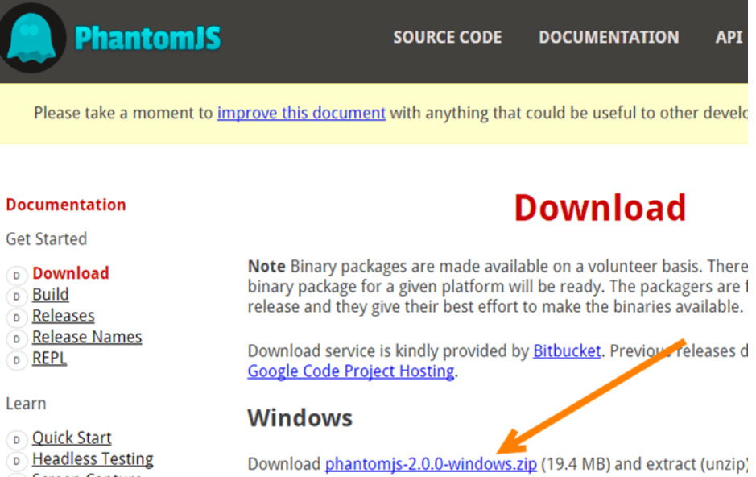
Steps for Download PhantomJS
PhantomJS is a headless browser with JavaScript API.
PhantomJS is an optimal solution for Headless Website Testing, access and manipulate webpages & comes with the standard DOM API.
Step 1) Go to Official website of phantomJS.

Slide 9
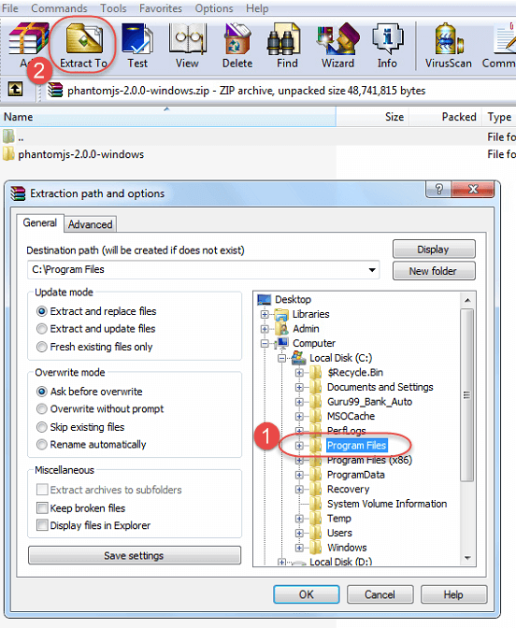
Step 2) Extract the downloaded folder to Program Files.
Step 3) Add the jar to the project see in next slide

Slide 10
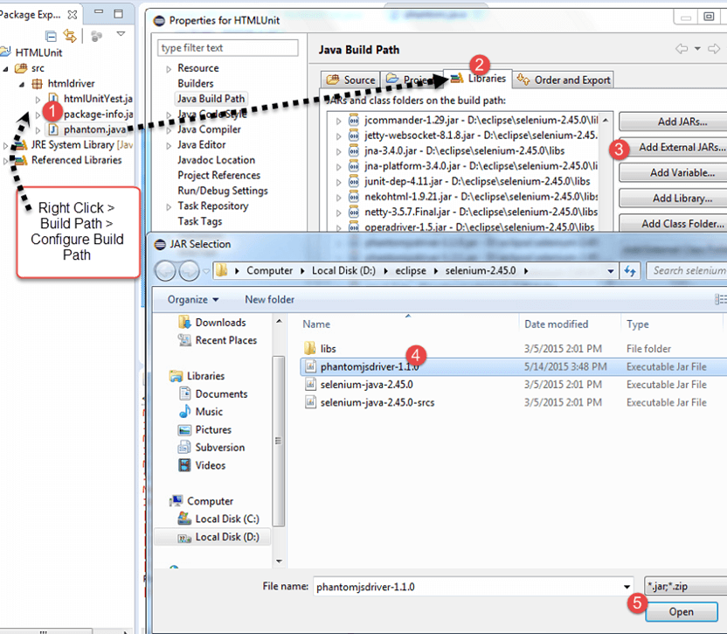
Step 4) Write the code in eclipse to see in next slide

Slide 11
package phantomjs;
import java.io.File;
import org.openqa.selenium.By;
import org.openqa.selenium.WebDriver;
import org.openqa.selenium.WebElement;
import org.openqa.selenium.phantomjs.PhantomJSDriver;
public class phantom {
public static void main(String[ ] args) {
File file = new File("C:/Program Files/phantomjs-2.0.0-windows/bin/phantomjs.exe");
System.setProperty("phantomjs.binary.path", file.getAbsolutePath()); WebDriver driver = new PhantomJSDriver(); driver.get("http://www.google.com");
WebElement element = driver.findElement(By.name("q"));
element.sendKeys(" facebook.com ");
element.submit();
driver.findElement(By.linkText(“facebook")).click();
System.out.println(" I am at " + driver.getTitle());
driver.quit();
}
}

Slide 12
Step 5) Run the code. You will observe the output is shown in console and no browser is launched.
Console Output:-
I am at Facebook
PASSED: phantomJSDriver
===============================================
Default test
Tests run: 1, Failures: 0, Skips: 0
===============================================
===============================================
Default suite
Total tests run: 1, Failures: 0, Skips: 0
===============================================

Slide 13
Advantages of PhantomJSDriver
Headless Testing
Screen Capture
Page Automation
Network Monitoring
To render dashboard screenshots for their users
To run Unit tests on command line
To generate employee handbooks from HTML to PDF
Combined with QUnit for the test suite

Slide 14
Covered Till Now
A headless browser is a web-browser without a graphical user interface.
HTML UnitDriver is the most light weight and fastest implementation headless browser of WebDriver.
PhantomJS is a headless browser with JavaScript API.
Download procedure of PhantomJs.
Benefits of HTMLUnitDriver and PhantomJs.

Slide 15
Thanks

